Slide 1
Before the Morning, there is dawn

Slide 2
Change might be good sometimes.

Slide 3

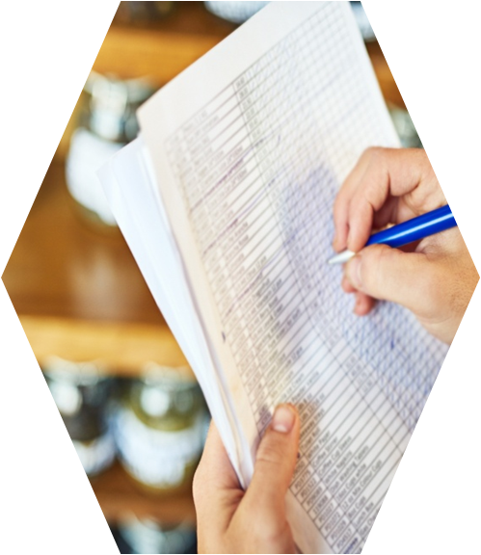
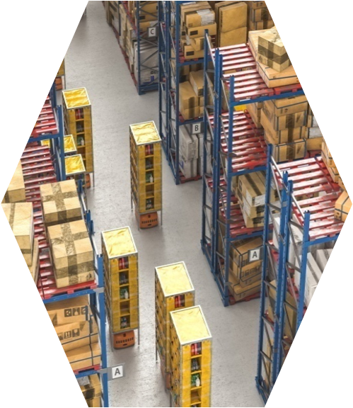
INVENTORY MANAGEMENT
A Basic Course

Slide 4
MODULE CONTENT
Concept and Importance
Dependent and Independent Demand
Inventory Systems: Continuous and periodical
Inventory Costs
Basic EOQ Model
ABC Classification
02

Slide 5
Inventory
Inventory refers to the goods or materials that a business holds for the ultimate goal of resale, production, or utilization.
In the context of a retail store, inventory includes all the goods available for sale to customers.
For manufacturers, inventory includes raw materials used to produce goods, work-in-process inventory, which are semi-finished goods, and finished goods that are ready for sale.
Department Stores hold clothing, furniture, carpeting, stationery, cosmetics, gifts, cards, and toys.
04

Slide 6

OBJECTIVES
• To maintain sufficient inventory
• To minimize the cost of inventory.
• To maintain steady production.
• To minimize wastes and losses.
• To maintain proper storage.
• To gain quantity discounts.
04

Slide 7
Inventory costs are the costs related to storing and managing the company's inventory. They can be broken down into three main categories:
Ordering Costs
Carrying Costs
Shortage Costs
INVENTORY COSTS
06

Slide 8
  1. ORDERING COST
These are the costs associated with placing orders for more inventory. This can include the cost of the labor used to make the order, shipping costs, and any costs associated with inspecting the incoming goods.
07

Slide 9
2. CARRYING COST
Also known as holding costs, these are the costs associated with storing the inventory that a company has on hand. This can include rent for the warehouse space, utilities, insurance, theft, spoilage, or obsolescence.
08

Slide 10
3. Stockout Costs
These are the costs associated with not having enough inventory on hand to meet demand. This can result in lost sales, customer dissatisfaction, and potential damage to the company's reputation.
08

Slide 11
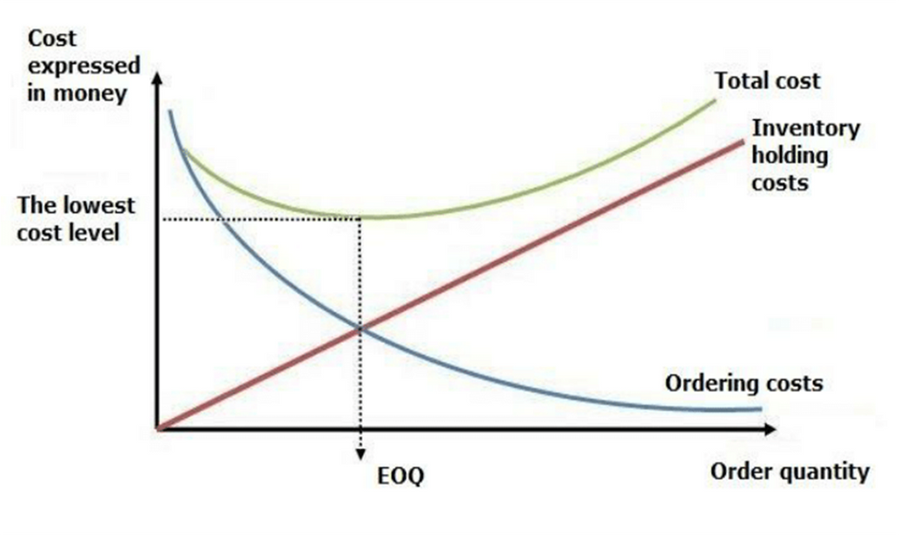
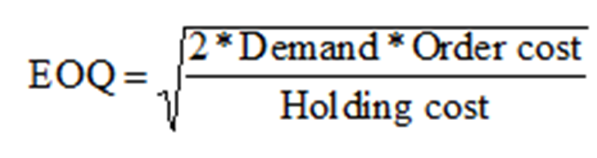
ECONOMIC ORDER QUANTITY (EOQ)
The order size of inventory at which total inventory costs remain the minimum. The total inventory cost is the minimum at the order size, where total ordering cost is equal to total carrying cost.
09

Slide 12
SOME KEY TERMS
  Average Inventory: Average level of inventory to be carried during the period according to the order size.
  Order size: The quantity of inventory to be ordered in a lot.
  Reorder point: The level of inventory according to the previous order at which a re-order is made.
  Safety Stock: The minimum level of stock of inventory to be maintained to avoid stock-out problems.
  Goods in Transit: The level of inventory for which order has been place but not received.
08

Slide 13
Types of Inventory Systems
There are two main types of inventory systems: perpetual and periodic.
Perpetual Inventory System: This type of system keeps track of inventory levels in real-time. Every time an item is added or removed from inventory, the system is updated. This allows companies to have an up-to-date and accurate understanding of their inventory levels at all times.
Periodic Inventory System: Under this system, inventory levels are updated at specific intervals. When the stock level of a given item is not sufficient to sustain production operations until the next scheduled review, an order is placed replenishing the supply. This system is less labor-intensive but may lead to inaccuracies due to the time lag between inventory changes and updates.
08

Slide 14
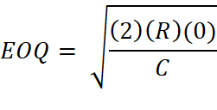
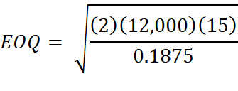

A company has an annual demand of 12,000 units of raw materials which cost Rs 1.25 per unit. Placing each order costs Rs 15 and the carrying costs are 15% per year per unit of the average inventory. Find the economic order quantity.
Given,
Annual Demand (R) = 12,000 units
Cost price of item per unit (P) = Rs 1.25
Ordering Cost per order (0) = Rs 15
Carrying Cost per unit per year (C) = 15% of Cost price
= 0.15 * Rs 1.25
= Rs. 0.1875
Solution,

Slide 15
EOQ: Economic Order Quantity
R: Annual Demand or Requirement
O: Ordering Cost per order
C: Carrying Cost per unit per year

Slide 16
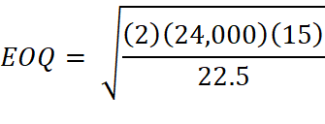

A company has an annual demand of 24,000 units of raw materials which cost Rs 150 per unit. Placing each order costs Rs 15 and the carrying costs are 15% per year per unit of the average inventory. Find the economic order quantity.
Given,
Annual Demand (R) = 24,000 units
Cost price of item per unit = Rs 150
Ordering Cost (0) = Rs 15
Carrying Cost per unit per year (C) = 15% of Cost price
= 0.15 * Rs 150
= Rs. 22.5
Solution,

Slide 17



Total Inventory Cost = Annual Ordering Cost + Annual Carrying Cost
EOQ: Economic Order Quantity
R: Annual Demand or Requirement
O: Ordering Cost per order
C: Carrying Cost per unit per year
N: Number of Orders in a year

Slide 18
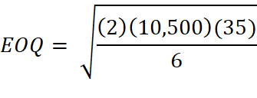



A company uses 10,500 units of an item annually. The ordering cost is Rs 35 per order and the carrying cost is Rs 6 per unit per year.
What are the annual holding costs?
What are the annual ordering costs?
Given,
Annual Demand (R) = 10,500 units
Ordering Cost per order (0) = Rs 35
Carrying Cost per unit per year (C) = Rs 6
Solution,

Slide 19



A company requires 65,000 units of an item annually. The ordering cost is Rs 45 per order and the carrying cost is Rs 12 per unit per year.
What are the annual holding costs?
What are the annual ordering costs?
Given,
Annual Demand (R) = 65,000 units
Ordering Cost per order (0) = Rs 45
Carrying Cost per unit per year (C) = Rs 12
Solution,

Slide 20
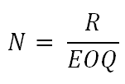
R: Annual Demand or Requirement
EOQ: Economic Order Quantity
N: Number of orders in a year

Slide 21

N: Number of orders in a year
T: Cycle Time or optimal reorder time

Slide 22
The production department of a company requires 5200 kg of raw materials for manufacturing a particular item per year. The cost of placing an order is Rs 25 and the cost of carrying inventory is 25 percent of the investment in the inventories. The price is Rs 15 per kg. Purchase manager wishes to determine an ordering policy for the raw material. Recommend the manager in the following aspects:
The Optimal Lot Size
Cycle Time or The Optimal reorder time
Given,
Annual Demand (R) = 5200 units
Ordering Cost per order (0) = Rs 25
Cost Price per Kg = Rs 15
Carrying Cost per unit per year (C) = 25% of Cost Price = 0.25 * 15 = Rs 3.75
Optimal Lot Size (EOQ) = ? Cycle Time or optimal reorder time (T) = ?

Slide 23
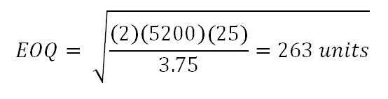
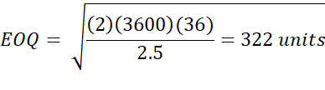

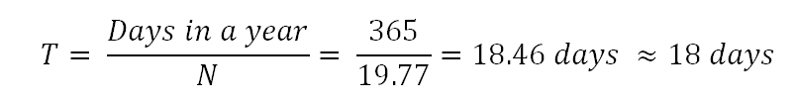
Given,
Annual Demand (R) = 5200 units
Ordering Cost per order (0) = Rs 25
Cost Price per Kg = Rs 15
Carrying Cost per unit per year (C) = 25% of Cost Price = 0.25 * 15 = Rs 3.75
Optimal Lot Size (EOQ) = ? Cycle Time or optimal reorder time (C) = ?
Solution,

Slide 24
The production department of a company requires 3600 kg of raw materials for manufacturing a particular item per year. The cost of placing an order is Rs 36 and the cost of carrying inventory is 25 percent of the investment in the inventories. The price is Rs 10 per kg. Purchase manager wishes to determine an ordering policy for the raw material. Recommend the manager in the following aspects:
The Optimal Lot Size
Cycle Time or The Optimal reorder time
Given,
Annual Demand (R) = 3600 units
Ordering Cost per order (0) = Rs 36
Cost Price per Kg = Rs 10
Carrying Cost per unit per year (C) = 25% of Cost Price = 0.25 * 10 = Rs 2.5
Optimal Lot Size (EOQ) = ? Cycle Time or optimal reorder time (C) = ?
Solution,

Slide 25
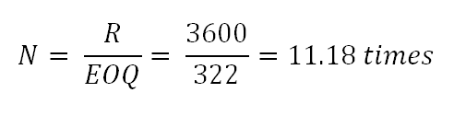
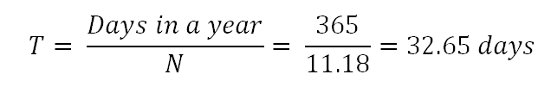
Given,
Annual Demand (R) = 3600 units
Ordering Cost per order (0) = Rs 36
Cost Price per Kg = Rs 10
Carrying Cost per unit per year (C) = 25% of Cost Price = 0.25 * 10 = Rs 2.5
Optimal Lot Size (EOQ) = ? Cycle Time or optimal reorder time (C) = ?
Solution,

Slide 26
The Reorder point is the inventory level at which a new order should be placed to replenish stock before it runs out.
Lead time refers to the duration between placing an order for inventory and receiving that inventory into stock. It encompasses the time it takes for the supplier to process the order, manufacture (if applicable), package, ship, and deliver the goods to the buyer's location.
Safety Stock is the buffer stock held to mitigate the risk of stockouts due to uncertainties in demand or lead time.
Goods in transit refers to inventory items that have been shipped from the supplier but have not yet arrived at the buyer's location.

Slide 28
ABC Company requires 12,000 units of materials annually. If ordering costs are Rs 250 per order, expected lead time is 5 days, unit cost is Rs 25 per unit and annual inventory holding cost are charged at 20% of the product price and the company operates for 250 days a year. Compute the following:
Economic Order Quantity
Re-order Level
Show the results graphically
Given,
Annual Demand (R) = 12,000 units
Ordering Cost per order (0) = Rs 250
Cost Price per Kg = Rs 25
Carrying Cost per unit per year (C) = 20% of Cost Price = 0.20 × 25 = Rs 5
EOQ =?
Re-order Level = ?

Slide 29

Given,
Annual Demand (R) = 12,000 units
Ordering Cost per order (0) = Rs 250
Cost Price per Kg = Rs 25
Carrying Cost per unit per year (C) = 20% of Cost Price = 0.20 × 25 = Rs 5
Lead time = 5 days
EOQ =?
Re-order Level = ?
Solution,

Slide 30


Given,
Annual Demand (R) = 12,000 units
Ordering Cost per order (0) = Rs 250
Cost Price per Kg = Rs 25
Carrying Cost per unit per year (C) = 20% of Cost Price = 0.20 × 25 = Rs 5
Lead time = 5 days
Days in a year = 250 days
Re-order Level = ?
Solution,
As Cycle Time (23 days) is greater than lead time (5 days), Goods in transit does not exit.

Slide 31
Inventory Level
EOQ = 1095
ROL = 240
L
L
L
Time
L = 5 days

Slide 32
ROL: Re-order level
EOQ: Economic Order Quantity
R: Annual Demand or Requirement

